Slide 1


Bone fracture detection
FUSE AI FELLOWSHIP 2023-2024

Slide 2

1. TEAM MEMBERS
Joaquin Ayzanoa (Perú)
…

Slide 3
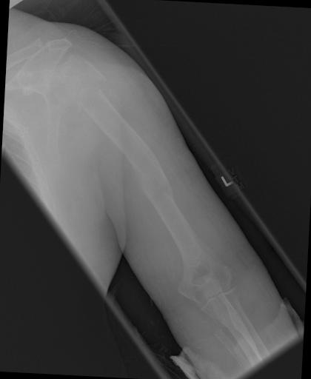
2. PROBLEM STATEMENT
A data set of bone fractures with which we want to train a machine learning model, specifically focusing on algorithms to automatically detect and classify bone fractures in X-ray images for better and fast registration for doctors and patients.

Slide 4
3. OBJETIVES
Detect and classify bone fractures in X-ray images for better and fast registration for doctors and patients.
Deploy the ML model with an interface so it can predict the type of fracture when someone upload an image.

Slide 5
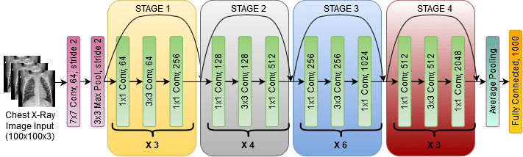
4. IMPLEMENTATIONS TECHNIQUES
CNN Resnet
FastAPI
Streamlit

